Slide 1




Risk Prediction of Survival of a Shipwreck

Slide 2

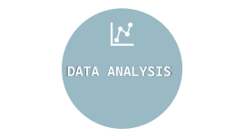






Slide 3

INTRODUCTION

Slide 4



INTRODUCTION
In this presentation, we will build a predictive model to answer the question: "What sorts of people were more likely to survive?" By utilizing passenger data, including name, age, gender, and socio-economic class, we will uncover patterns and insights that contribute to the likelihood of survival. Through data visualization and statistical analysis, we will gain a deeper understanding of the demographics and characteristics that played a crucial role in this historic tragedy

Slide 5

DATA ANALYSIS

Slide 6


DATA ANALYSIS
In our analysis of the Titanic dataset, we utilize various data visualization techniques to uncover patterns and insights related to passenger survival
Bar Plot & Pie Chart
Scatter Plot
Stacked Bar Chart
Line Chart
Box plot
Dot plots
Density Plot
Histogram
Strip Chart
Violin Plot

Slide 7
Research
i. what sorts of people were more likely to survive?
ii. What factors are associated with passenger survival?
iii. How does passenger class affect survival rates?
iv. Does age influence the likelihood of survival?
v. Are there any differences in survival based on gender?
Objectives
i. To determine the relationship between passenger demographics age and survival.
ii. To assess the impact of socio-economic status (represented by passenger class) on survival rates.
iii. To evaluate the influence of family presence (sibsp, parch) on survival chances.
iv. To determine the relationship between passenger demographics gender and survival.
Hypotheses
Younger passengers have a higher survival rate than older passengers.
First-class passengers have a higher survival rate compared to second and third-class passengers.
Passengers with family members aboard (higher sibsp and parch) have a higher survival rate than those traveling alone.
Female passengers have a higher survival rate than male passengers..

Slide 8

DATA VISUALIZATIONS

Slide 9



DATA VISUALIZATIONS
it's important to effectively convey the insights derived from the visual representation of data. Here’s a structured approach to describing a data visualization.
Okey Lets move to the next presentashion

Slide 10

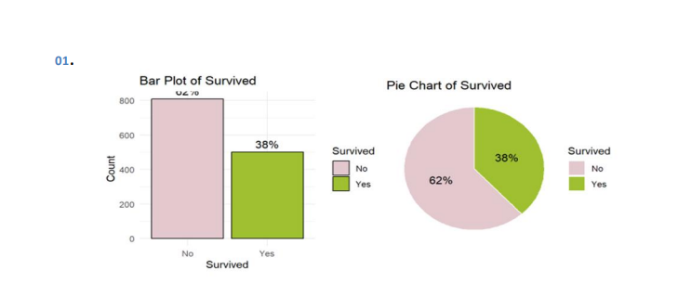
DATA VISUALIZATIONS
Comparing the bar graph and pie chart allows for different interpretations of the distribution of passenger survival count. The bar graph provides a clear visual comparison of counts, while the pie chart emphasizes the proportions of individuals who survived and not survived relative to the total population. From these visualizations, it is evident that a significant number of passengers did not survive.

Slide 11
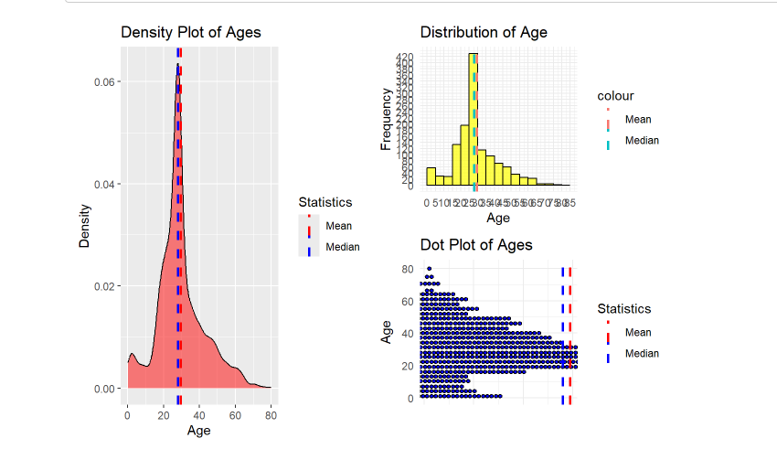
DATA VISUALIZATIONS
Visualization of age in the context of passenger survival analysis serves as a fundamental aspect of data exploration and understanding. Through various visualization techniques such as histograms, dot plots, and density plots, we can gain valuable insights into the distribution of age and its relationship with survival outcomes. Our analysis reveals that a significant number of passengers are between the ages of 20 and 40, highlighting a key demographic in the dataset.

Slide 12
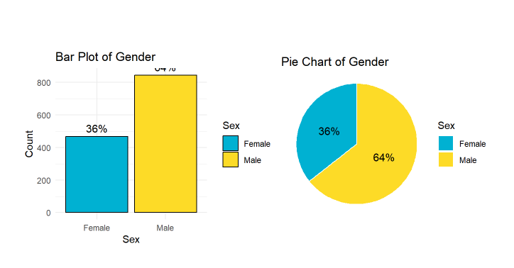
DATA VISUALIZATIONS
A pie chart & bar chart provides a simple and intuitive representation of the proportion of male and female passengers. We can take gender status and their count, offering a better understanding of its impact on passenger survival. From these visualizations, it is clear that there were many male passengers on the boat

Slide 13
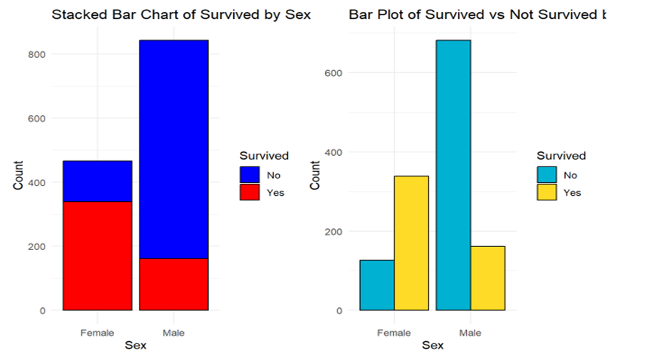
DATA VISUALIZATIONS
The conclusion drawn from this analysis is that there were many more males overall, but a notable proportion of the male passengers didn’t survive compared to the female passengers

Slide 14
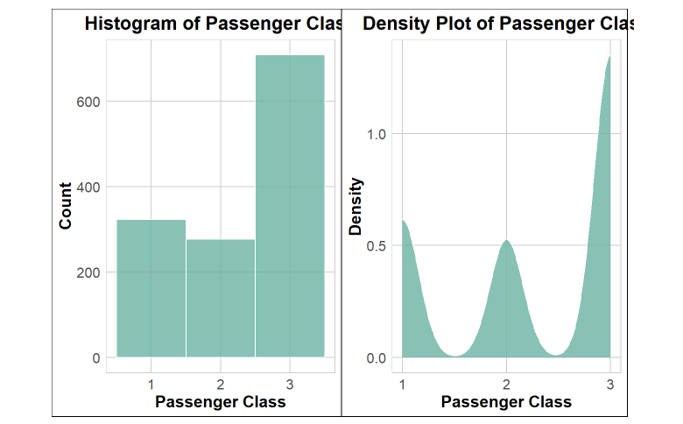
DATA VISUALIZATIONS
This histogram and the density plot show the passenger count and density in each passenger class. According to the graph we can see that there are approximately 300 passengers in the 1st class, 250 passengers in the 2nd class and 700 passengers in the 3rd class. The largest number of passengers are in the 3rd class. In the density plot we can see the highest peak is in the 3rd class indicating the high concentration of passengers.

Slide 15
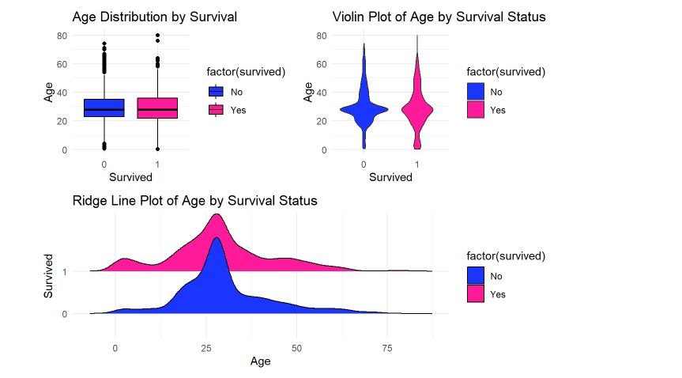
DATA VISUALIZATIONS
These graphs show that the age was a huge factor when considering about the passenger survival. In these graphs we can see the younger passengers were able to survive more than the older passengers showing that the age is an important factor in this kind of an incident.
Notes:
. In these graphs we can see the younger passengers were able to survive more than the older passengers showing that the age is an important factor in this kind of an incident.

Slide 16
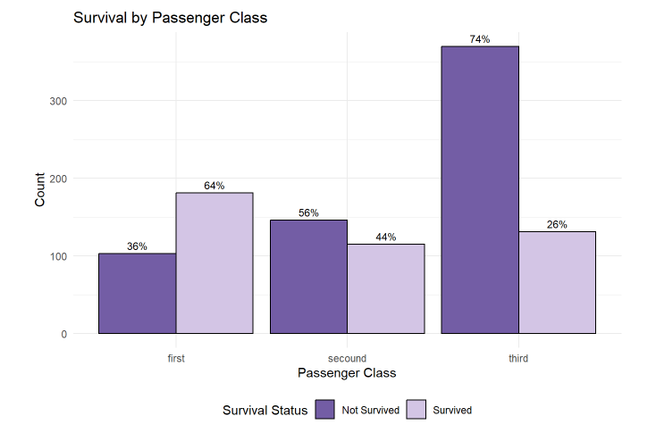
DATA VISUALIZATIONS
In this context of passenger class, the bar graph will display the proportions of passengers who survived and not survived based on passenger class. By using this bar graph, we can get a visual idea about the effectiveness in passenger class in passenger survival. The conclusion drawn from this analysis is that a lot of passengers in third class did not survive.

Slide 17
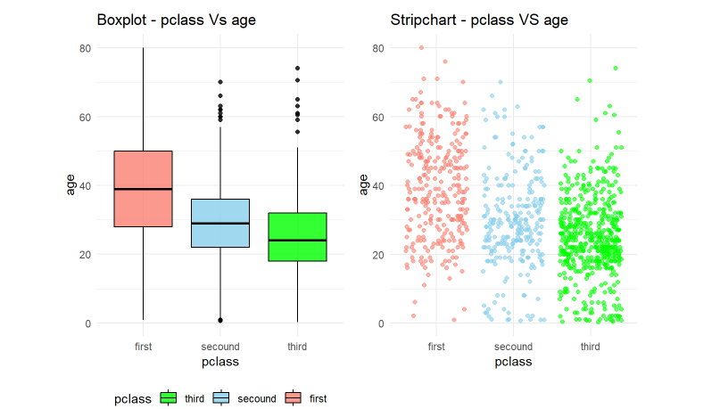
DATA VISUALIZATIONS
This box plot and the strip chart compare the passenger class and the age variables. By analyzing the box plot we can interpret that the 1st class median age is higher compared to other classes. This shows the socio-economic difference meaning wealthier passengers are older and occupying the 1st class. The strip chart shows the distribution of the age across a wider range to show more diversity. And show more younger passengers were occupying the 3rd class.

Slide 18
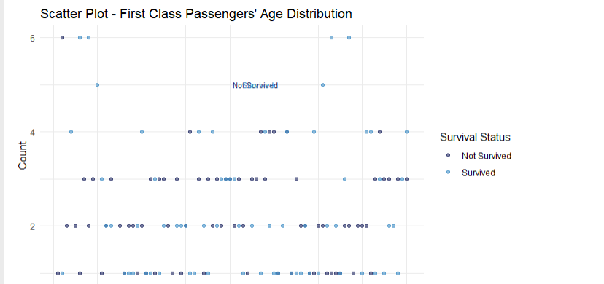
DATA VISUALIZATIONS
This scatter plot shows the age distribution in the 1st passenger class. By using this graph, we can analyze the age of the passengers in the 1st class and see which age group passengers survived and not survived. The conclusion drawn from this analysis is that many passengers in the 1st class survived compared to the overall number of 1st class passengers

Slide 19
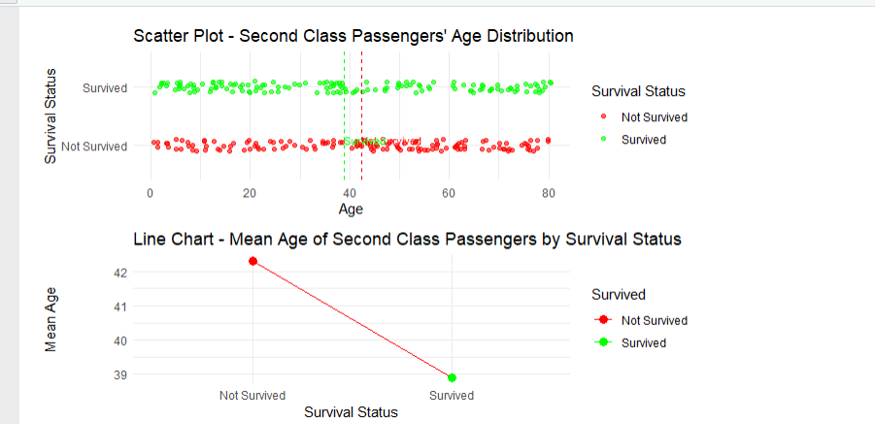
DATA VISUALIZATIONS
This scatter plot shows the age distribution in the 2nd passenger class. By using this graph, we can analyze the age of the passengers in the 2nd class and see which age group passengers survived and not survived. The conclusion drawn from this analysis is that many passengers in the 2nd class not survived compared to the overall number of 2nd class passengers.

Slide 20
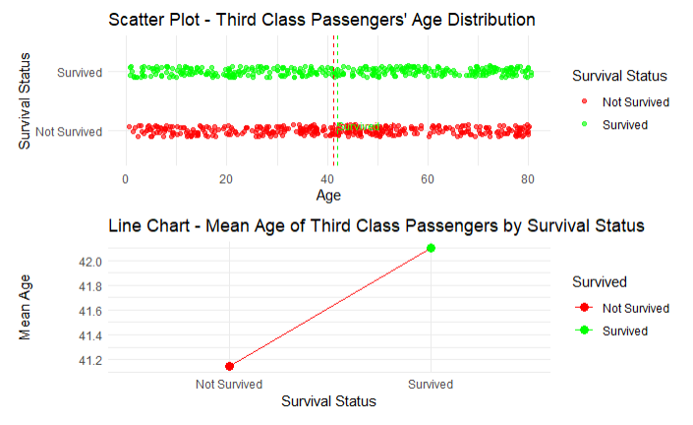
DATA VISUALIZATIONS
This scatter plot shows the age distribution in the 3rd passenger class. By using this graph, we can analyze the age of the passengers in the 3rd class and see which age group passengers survived and not survived. The conclusion drawn from this analysis is that many passengers in the 3rd class survived compared to the overall number of 3rd class passengers.

Slide 21
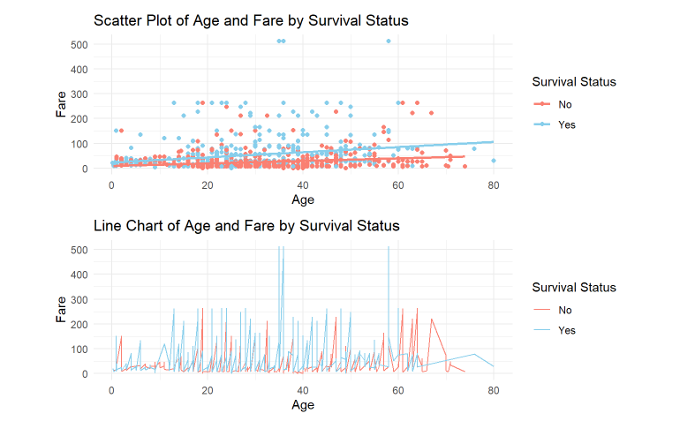
DATA VISUALIZATIONS
In this chart we compare between age and fare variables. According to this chart we can see that higher the fare higher the survival rate of the passengers.

Slide 22
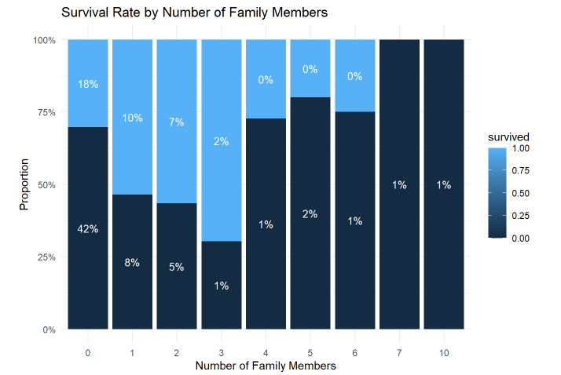
DATA VISUALIZATIONS
This stacked bar graph shows the survival rate based on the number of family members aboard. By analyzing this graph, we can see that passengers who has higher number of family members aboard survived more than the other categories.

Slide 23

MODEL EVALUATION

Slide 24

MODEL EVALUATION
Logistic Regression Model
When evaluating a logistical regression model, we use to analyze the testing dataset to make predictions using probability, p-values and other recognizing values. Using this model, we can analyze categorical variables with numerical variables to check the survival rates of passengers depending on several factors such as age, sex, passenger class(Pclass), siblings and spouses(sibsp), parents and children(parch). We use survival as the main factor to see the what factors increase or decrease the survival of passenger. According to the model data we can see a model Accuracy of “0.779….” when predicting the output.
It shows the significance level (p-value) of a factor using *** marks according to this model most of the variables that we have used for this model have p-value < 0.001 indicated by *** star notations.

Slide 25
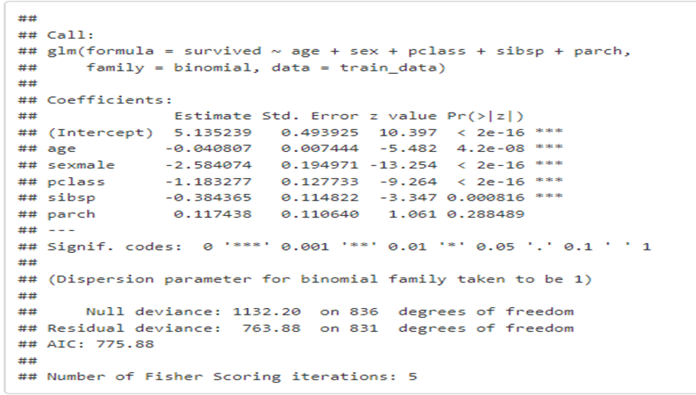
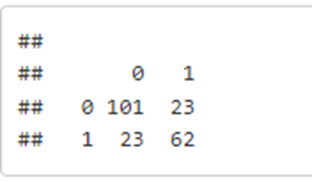
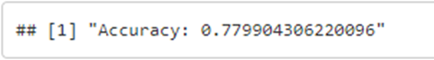
MODEL DATA
Model values
Probability values
Predicted values
Accuracy

Slide 26

PREDICTION

Slide 27

PREDICTION
These predictions are the model's estimates of the dependent variable (survival) for specific test data points. The 1st image shows 1st few predicted probabilities using the model. If the probability is closer to 1 it shows that passenger has a higher probability in survival. The 2nd image shows the predicted survivals vs actual survived number of passengers. The model correctly predicted 101 passengers died and 62 passengers survived. It also wrongly predicted 23 passengers survived and 23 passengers died.
These predictions can be further analyzed by using accuracy, precision and other identifying values. In this model it shows a accuracy of 78% and based on this we can say this model able to make prediction accurately based on the data provided.

